Slide 1

Twitter Research updates, 2020-12-02
Mark torres

Slide 2
Outline
Past Work
General Approach
Data Collection
Exploratory Data Analysis
Topic Models
(Possible) Next Steps
(All scripts stored at https://github.com/ngandhi01/TextMining)

Slide 3
Past work
Use multimodal approach
Different ways to frame the question:
What is the fewest number of tweets we need in order to classify a person’s tweets as depressed or not?
Various ways of obtaining data (via Twitter):
E.g., Ask Amazon Mturk workers to share their Twitter profiles, fill out depression questionnaire
E.g., having people hand-label if a tweet indicated mental health status or not
E.g., taking tweets that say “I have depression” and using those as ground truth labels

Slide 4
Features used in Multimodal approaches
User text
Text itself
Proportion of positive/negative words
Proportion of keywords (e.g., “depression”, “anxiety”)
Images in the tweet
User Twitter behaviors/characteristics
What time did they post?
How many tweets are they posting?
How many of their posts are RTs, @ mentions, replies?
How many followers do they have?
Demographics

Slide 5
Possible project approach
Use multimodal data:
Tweet text
User information / Twitter behavior
Demographics / location
Topic assignment of tweet (from LDA, topic models)
Pass into model (e.g., LDA, SVM, neural network, etc.)
Make predictions about mental health status of individual

Slide 6
Data collection
Scraped three sets of tweets:
2020-11-25: Scraped 25,000 COVID tweets (keywords: covid19, coronavirus, lockdown)
2020-11-30: Scraped 35,000 depression tweets (keywords: depression, anxiety, fear, worry, distress, suicide, pain)
2020-11-30: Scraped 35,000 miscellaneous tweets (keywords: happy, alive, brave, confident, sport, office, animal, meal, computer)
After data cleaning, the number of tweets in each set was:
COVID tweets (2020-11-25): 8,178 (original: 25,000)
Depression tweets (2020-11-30): 15, 777 (original: 35,000)
Miscellaneous tweets (2020-11-30): 14, 811 (original: 35,000)
Note: this dataset hasn’t been used yet. It might be used in the future as a “control” dataset of tweets not referring to either mental health or to COVID
Total number of tweets: 38, 766

Slide 7
Text Preprocessing steps
1. Remove RTs, verified accounts (filters out ~60% of tweets)
2. Stemming/Lemmatization
3. Remove links, mentions to users (@ mentions)
4. Remove punctuation
5. Remove stopwords

Slide 8
Exploratory data analysis

Slide 9
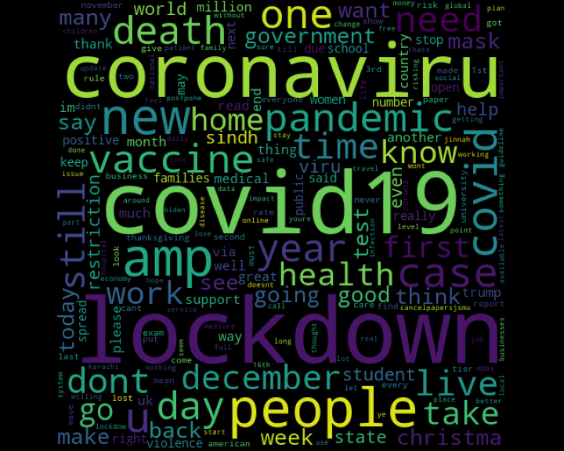
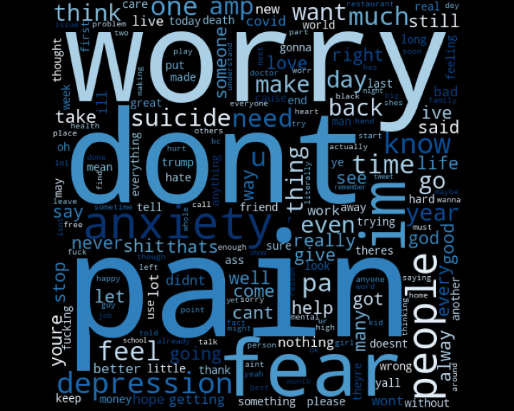
Word clouds
COVID tweets, November 25th, 2020
Mental health tweets, November 30th, 2020

Slide 10
Topic model (COVID)

Slide 11
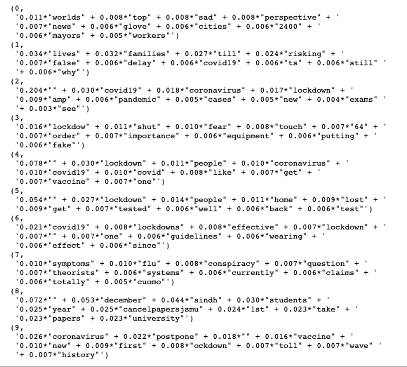
Topic model (COVID)

Slide 12
Topic model (Mental health)

Slide 13
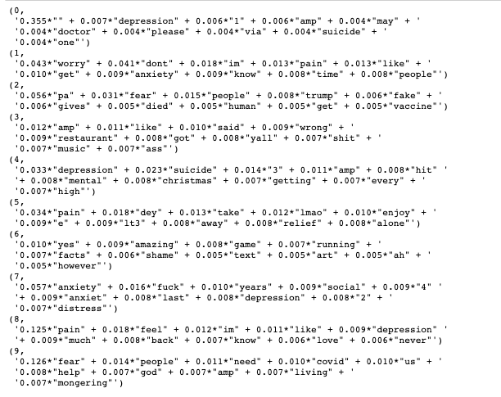
Topic model (Mental health)

Slide 14
Current questions in approach
What exactly are we answering? How can we ensure that what we’re measuring is valid?
(Chancellor & De Choudhury, 2020): mental health research in social media isn’t grounded in clinical or theoretical foundations
Doing a raw keyword search on Twitter leads to many false positives
E.g., “It’s sad to see that our baseball team lost today” != “depression”
Possible Solution: Some research filtered for specific phrases (e.g., “I feel depressed”)
Hard to build a predictive model without “ground truth” labels
Past research crowdsourced, using Amazon Mechanical Turk, to get information about which Twitter users reported symptoms of depression and at what point in time
Possible Solution: use topic models + sentiment analysis, in order to classify tweets as pertaining to mental health
Possible Solution: use pre-labeled dataset for detecting mental health tweets (e.g., Owen, Camacho-Collados, and Espinosa-Anke, 2020).
Language of post != presence of mental health concerns (at least, in the absence of ground truth labels)
E.g., self-deprecation or sarcasm
People’s well-being can change over time. How can we determine which posts to use to study their mental well-being?

Slide 15
(possible) Next steps
1. Where do we get data? How do we obtain “ground truth” labels?
Option: Scrape tweets from different points in time
Which dates/times to scrape tweets from?
How many tweets to scrape?
Scrape tweets using keywords?
Option: use a pre-labeled dataset
E.g., https://bitbucket.org/nlpcardiff/preemptive-depression-anxiety-twitter/src/master/DATD/
Option: use a pre-collected set of COVID tweets (tweet IDs are provided, would just need to obtain actual tweet text)
E.g., https://ieee-dataport.org/open-access/coronavirus-covid-19-geo-tagged-tweets-dataset

Slide 16
(possible) Next steps
2. Measure “sentiment” of tweets over time:
Are people posting more about mental health issues as the pandemic progresses?
Can any trend be associated to COVID trends /timelines (e.g., do more people post about mental health issues as states go into lockdown)?
Possible approaches:
Topic models
Using fine-tuned NLP model (e.g., BERT, fine-tuned to detect depression) or a pretrained model, in order to perform sentiment classification
Past work:
https://ieee-dataport.org/open-access/coronavirus-covid-19-geo-tagged-tweets-dataset

Slide 17
Fin

